Slide 1
Group 12:
Ruksar Lukade - 37 Alexandre Broggi - 12 Mousami Biswas - 11
Predicting 30-Day
Hospital Readmissions
for Diabetic Patients
Notes:
Notes: show code and explain why we are looking at the data

Slide 2
1. Problem Statement
We have found a comprehensive dataset containing information about clinical care for patent care over the years 1999 to 2008.
We will analyze the data and attempt to form a prediction model for if a patient returns within 30 days of their initial release.
Our primary objective is to predict and analyze whether patients will return for hospital readmission within 30 days.
This is to provide valuable insights into healthcare practices and patient characteristics that can help reduce readmissions, ultimately improving patient care.
We will also be able to provide information as to whether medical information should be kept on-hand for possible fast readmission or to return the files to the filing system.

Slide 3
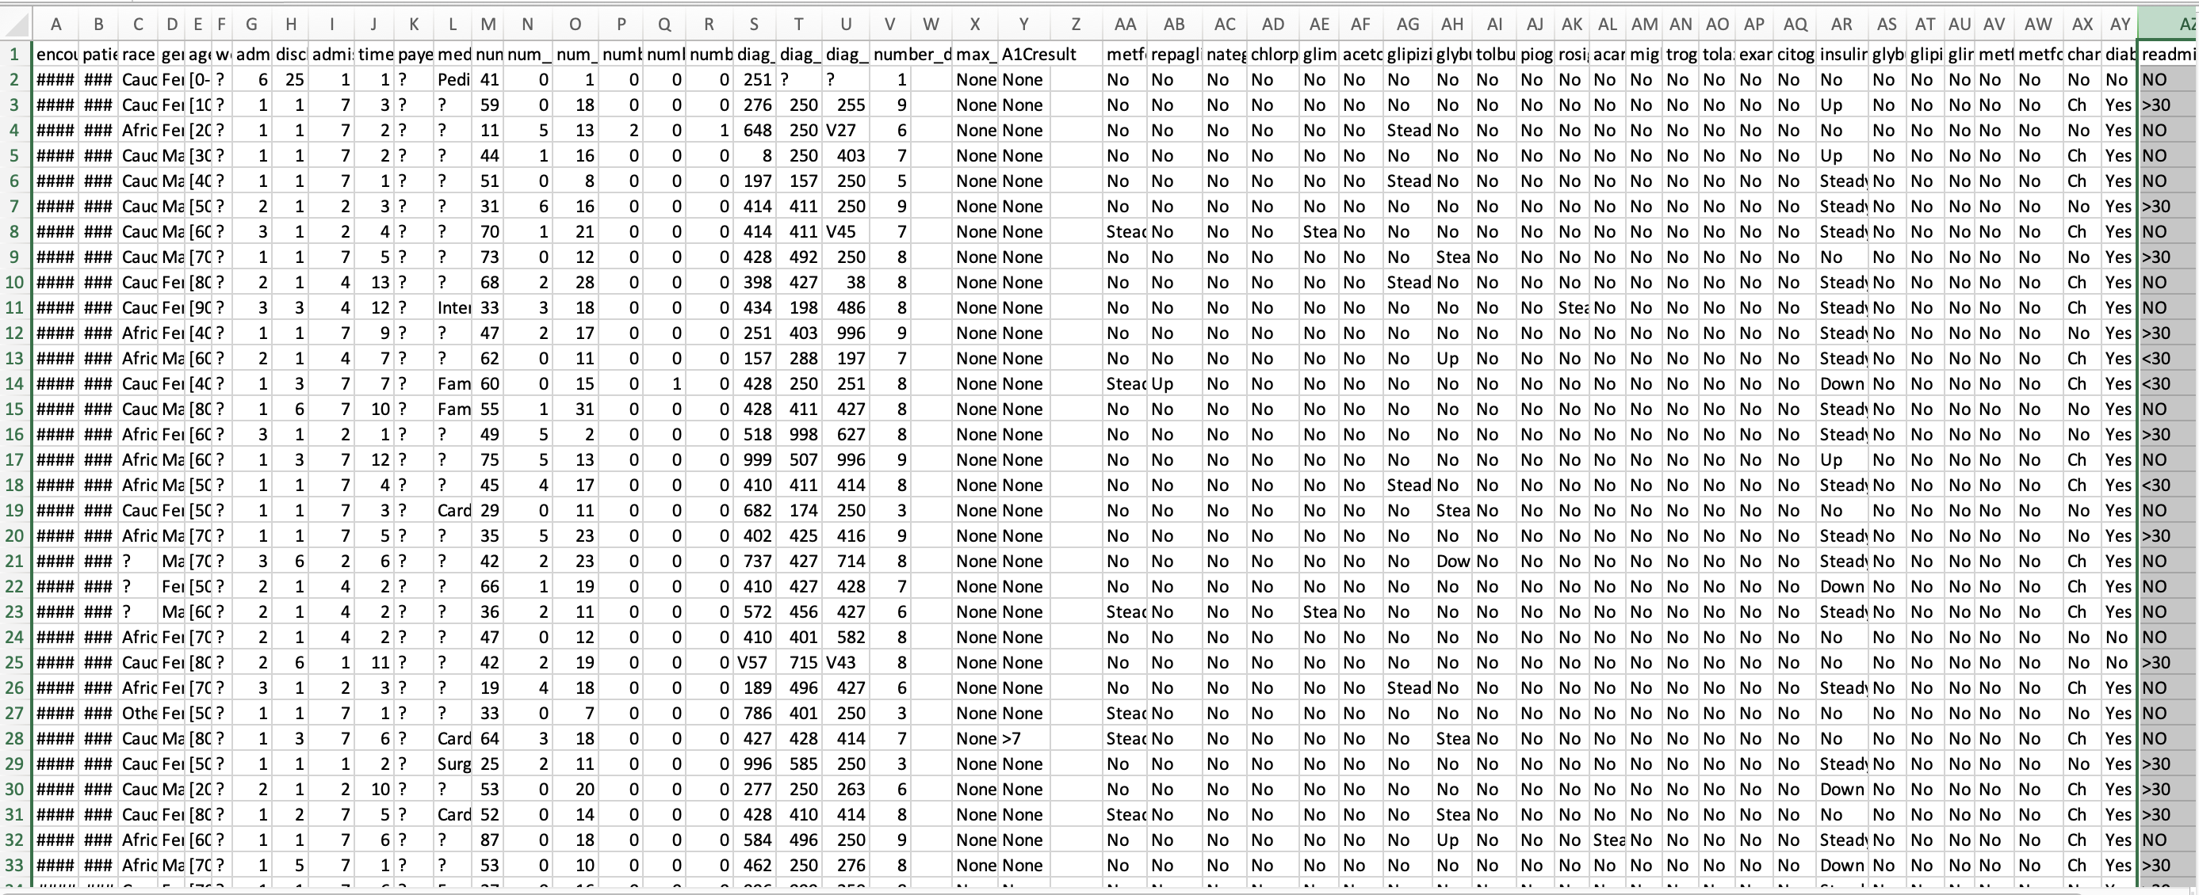

Slide 4
2a. Collect Dataset
We are using the “Diabetes 130-US hospitals for years 1999-2008” dataset that contains 100k entries from 150 hospitals across the United States.
The dataset contains 50 features, most of which can be used for our research. These features contain both ordinal and non-ordinal data.
The information was collected with the following five filters, as described by the original creators of the dataset:
It is an inpatient encounter (a hospital admission).
It is a diabetic encounter, that is, one during which any kind of diabetes was entered into the system as a diagnosis.
The length of stay was at least 1 day and at most 14 days.
Laboratory tests were performed during the encounter.
Medications were administered during the encounter.
Notes:
UCI Machine Learning Repository

Slide 5
2b. Data Pre-processing
To clean the dataset used in the tests we used a 5-step process:
Define the blank values, the dataset was created using “?” as blank values and “None” as a true value. Standard
Define dictionaries for Ordinal data
Drop ID columns
Map ordinal values to numerical values
Use Pandas.get_dummies() to create non-Ordinal data columns
This process leaves us with 96 columns to work with. This number will need to be narrowed down a bit in the feature selection stage.
Target feature is converted to binary during step 5 mapping.

Slide 6
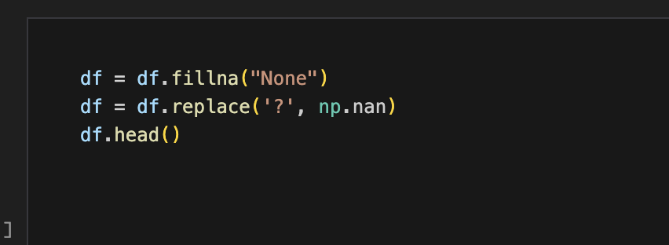
2b.1. Fill blank values

Slide 7
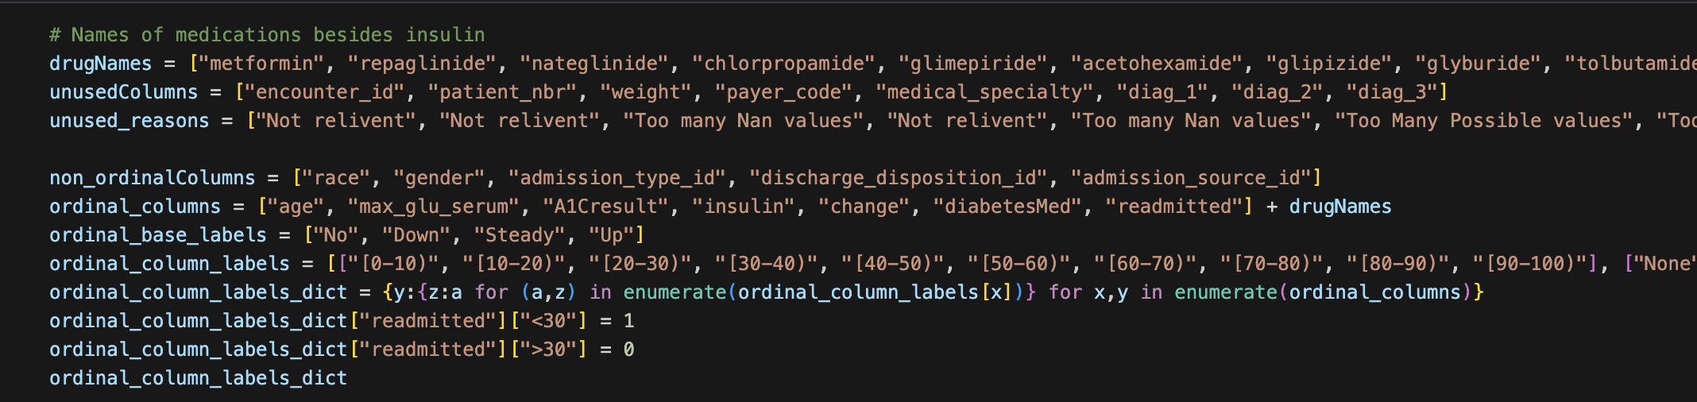
2b.2. Define dictionaries

Slide 8
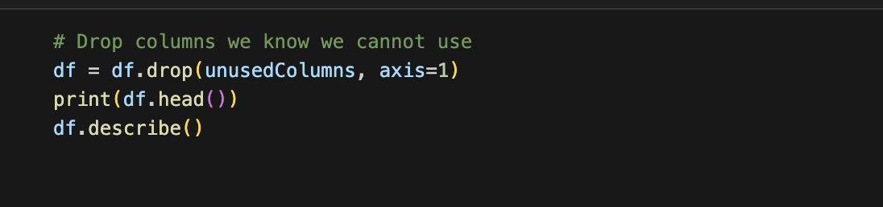
2b.3. Drop Identification columns

Slide 9
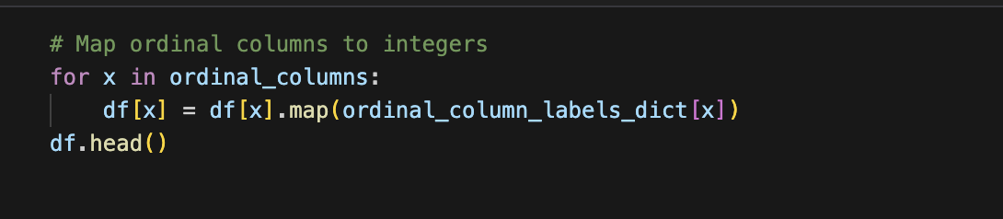
2b.4. Map Ordinal values

Slide 10
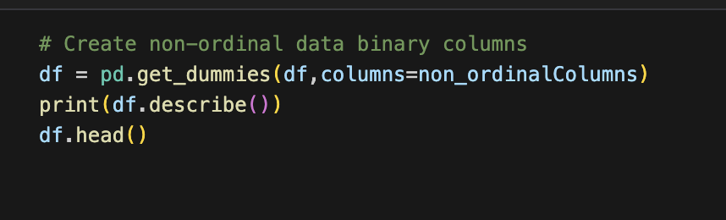
2b.5. Map Non-Ordinal values

Slide 11
2b. Data Pre-processing expanded
Define the blank values: The dataset was created using “?” as blank values and “None” as a true value. The standard Pandas csv read function treats the string “None” as null values, so those needed to be swapped.
Define dictionaries for Ordinal data: Most of the ordinal data was in the form ["No", "Down", "Steady", "Up"] or similar, so we created dictionaries to map strings to the corresponding values, such as [0,1,2,3]. We also defined which columns were non-Ordinal data during this step.
Drop ID columns: ID columns are unique and cannot be trained on. They will be dropped even before feature selection.

Slide 12
2b. Data Pre-processing expanded (Cont.)
Map ordinal values to numerical values: Use the previously defined dictionaries to map each value in the ordinal columns with a numerical value that can be used for model training. This includes mapping the target feature, ”readmittance”, to 0 and 1.
Use Pandas.get_dummies() to create non-Ordinal data columns: Use the columns found in step 2 to create a binary column for each of the non-Ordinal data column values.

Slide 13
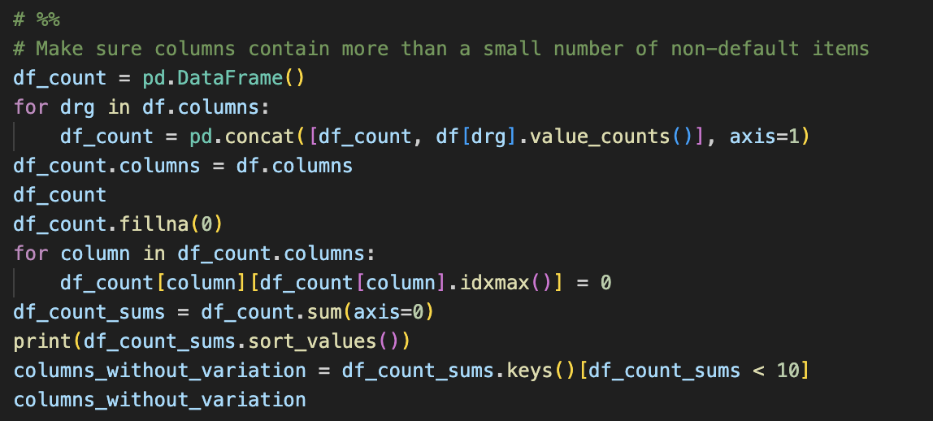
Ensure Variation in Non-continuous data

Slide 14
3. Exploratory Data Analysis
To better understand how our data is related to the problem we first evaluate it by using a few graphs and charts, including:
A correlation matrix heat map
A box and whisker chart
A histogram
A scatter plot
We have found that the dataset is imbalanced so to counter that we will be using under sampling as we are just analyzing how well different algorithms work, full deployment should instead use a method for oversampling.

Slide 15
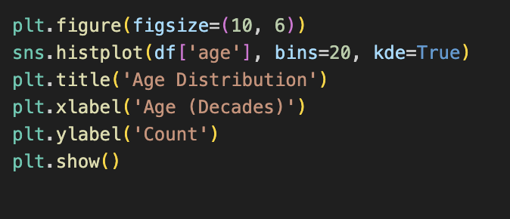
Generate Histogram

Slide 16
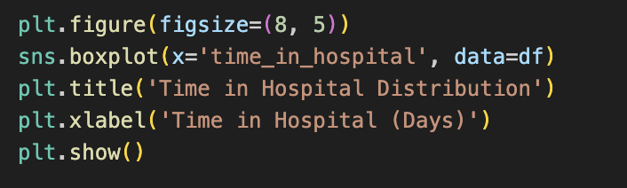
Generate Boxplot

Slide 17
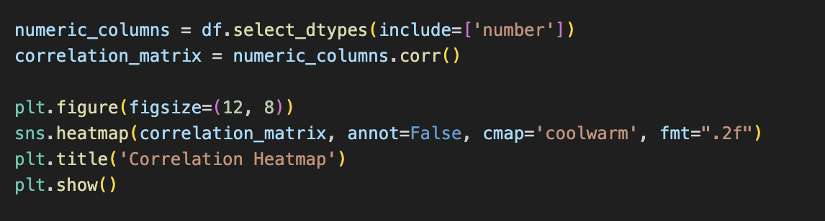
Generate Correlation

Slide 18
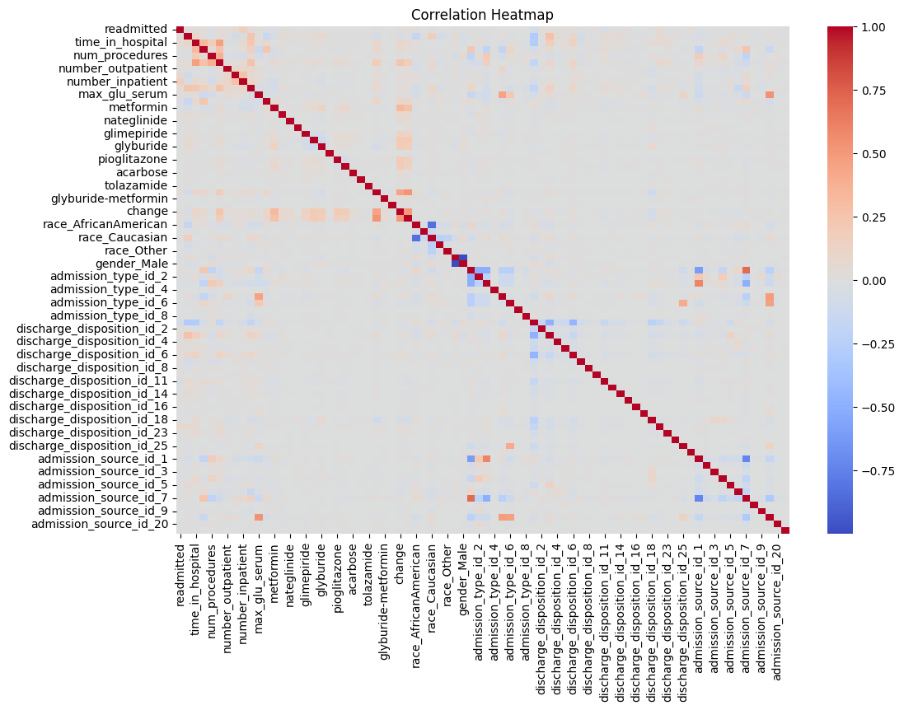
3.1. Correlation
The correlation matrix is not as helpful as it might be due to the process of splitting all non-ordinal data.
Binary values are only 0 or 1 so it becomes difficult for them to have a correlation with other values.
The highest correlations seem to be in groups with the inverted binary value.
Additionally, only number_inpatient seems to have correlation with readmitted.

Slide 19
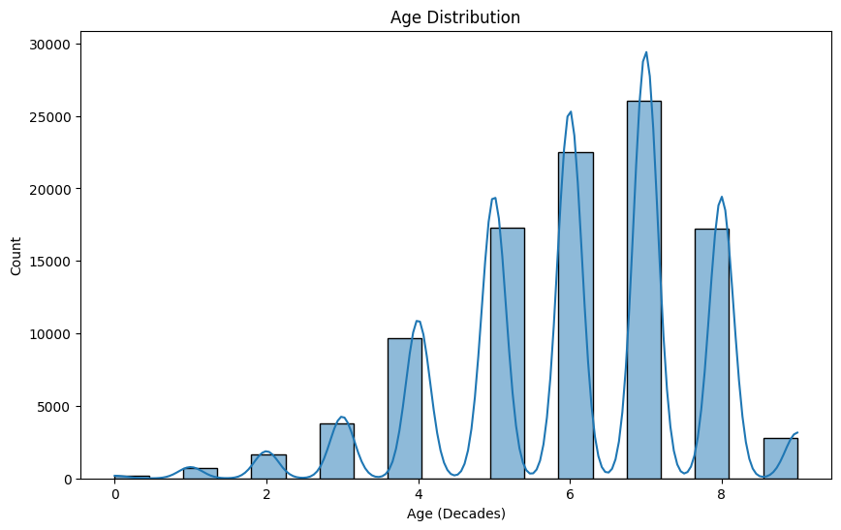
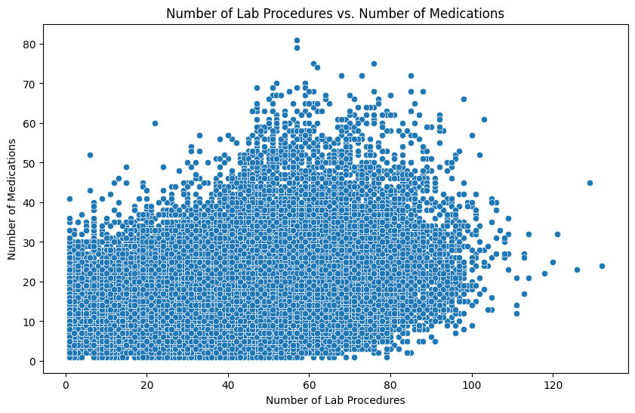
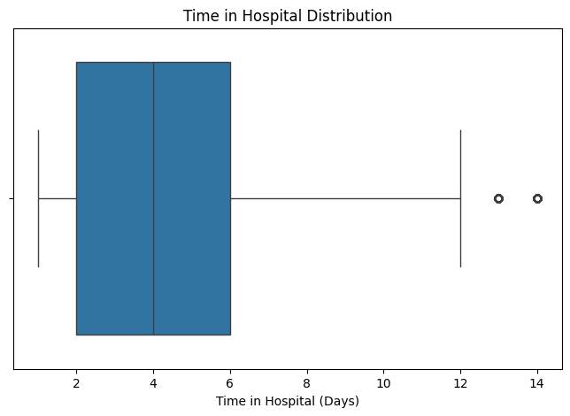
3.2 More charts
Here you can see a sample feature from the dataset that we will be using.
This is the patient’s age in decades, we see that most of the data we have is from people ages 50-80.
This data did not have anyone over the age of 100.
We can use a box and whisker chart to identify outliers in the dataset.
Here we see that the time in the hospital is mostly 2-6 days with two outliers at 13 and 14 days.
Scatter plots can tell us rough correlations between some of the data at a more fine-grained level than correlation matrixes
Specifically, this is showing us that high numbers of medications do not occur without at least some lab procedures and vice versa.

Slide 20
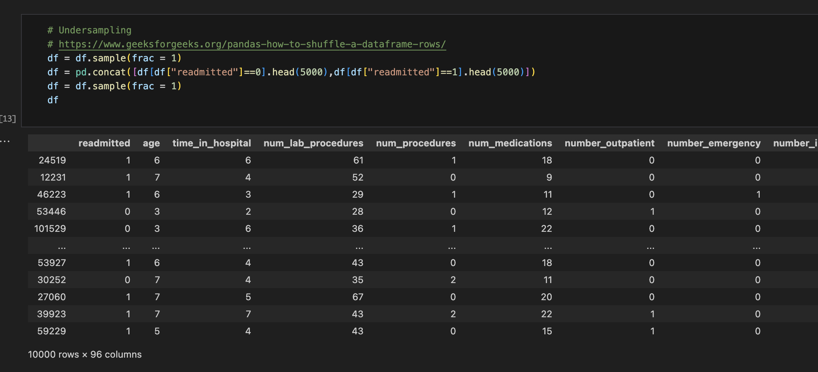
Under Sampling

Slide 21
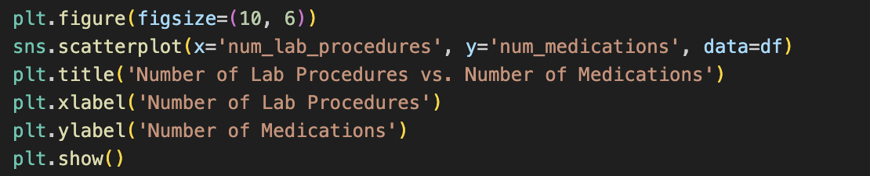
Generate Scatterplot

Slide 22
4. Feature selection
To get the best model performance we select data that shows correlation with the target feature, which in this case is if the patent returned within 30 days.
To do this, we remove columns that show too little variation, this is done by identifying columns which have fewer than 10 instances where they are not their most common value. Dropping those brings us down to 78 columns for feature selection.
Feature selection is also where we split the data into training and testing. We decided not to use a validation set for our work.

Slide 23
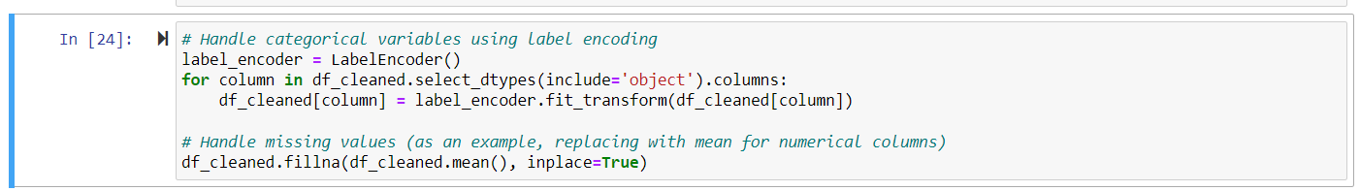
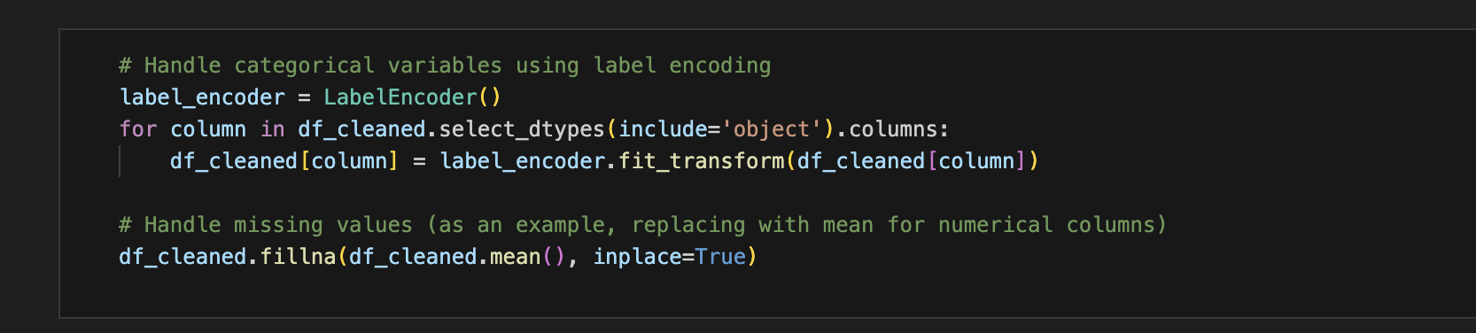
Readmitted as the target variable for different ML Models

Slide 24
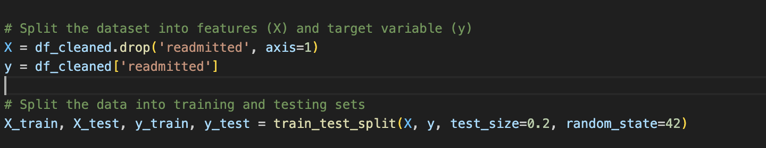
Splitting train/test

Slide 25
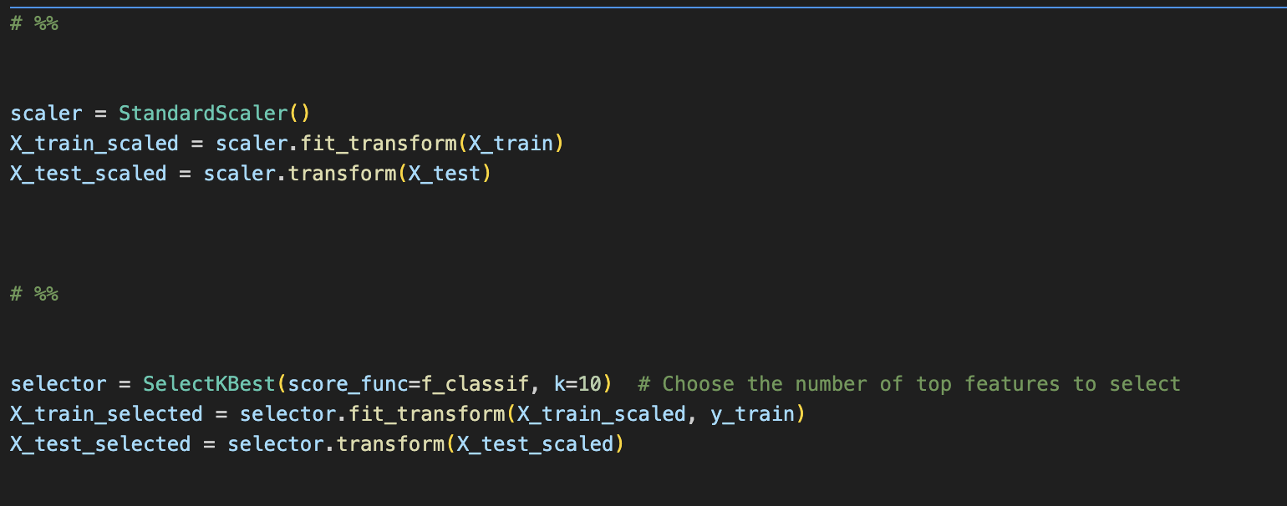
Scaling and selection

Slide 26
5. Model Building
We decided to use many models to evaluate the data to identify which type of model works best, due to time constraints we were unable to tune the majority of the models.
We used:
XGBoost
Logistic Regression
Random Forest
Gradient Boosting
Artificial Neural Network
Decision Tree
K Nearest Neighbors
Notes:
XGBoost
Logistic Regression
Random Forest
Gradient Boosting
Artificial Neural Network
Decision Tree
K Nearest Neighbors

Slide 27
6. Model Evaluation
Model name | F1 Score
XGBoost | 61.7%
Logistic Regression | 59.6%
Random Forest | 62.5%
Gradient Boosting | 63.1%
Artificial Neural Network | 61.7%
Decision Tree | 54.7%
K Nearest Neighbors | 57.7%

Slide 28
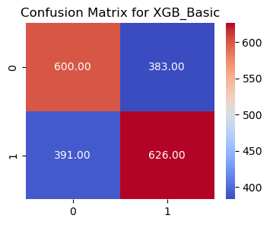
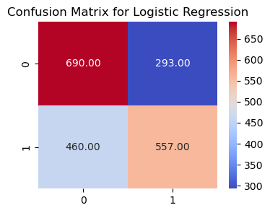
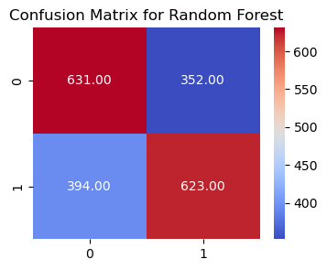
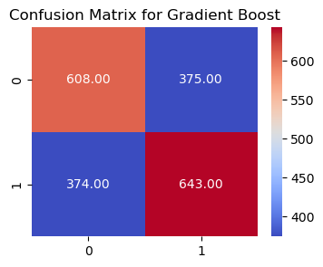
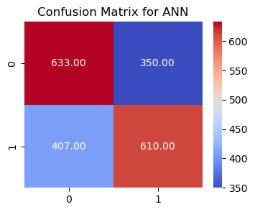
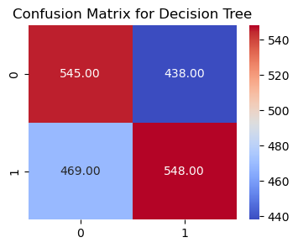
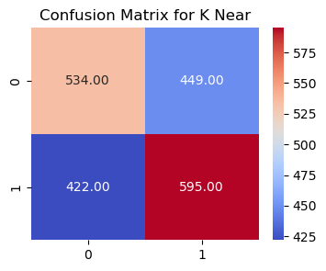
6.1. Confusion Matrices

Slide 29
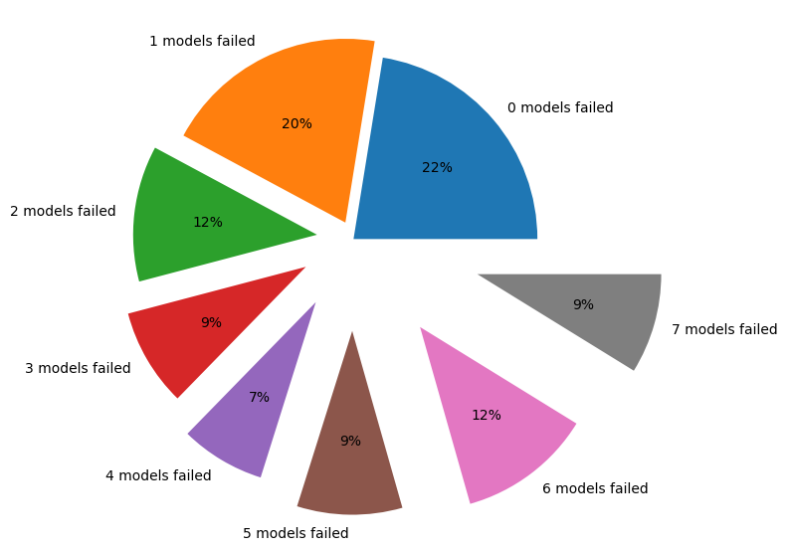
6.2. Pie Chart of Model Failures
63% success rate for a possible ensemble model

Slide 30

7. Interpretation and Insights
Upon analyzing the dataset and building various machine learning models, it becomes evident that the features available in the dataset do not exhibit a strong correlation with the likelihood of readmittance. The attempted models, including XGBoost, Logistic Regression, Random Forest, Gradient Boosting, Neural Network, Support Vector Classifier (SVC), Decision Tree, and K-Nearest Neighbors, did not yield satisfactory predictive performance.

Slide 31

Feature Correlation:
The correlation analysis and feature importance assessments did not reveal strong relationships between the provided features and the readmittance variable. This lack of correlation indicates that the existing features might not be sufficient to accurately predict readmission.
Model Performance:
The models employed, such as XGBoost, Logistic Regression, and others, demonstrated limited success in accurately predicting readmission within 30 days. The confusion matrices and evaluation metrics, including accuracy, precision, recall, and F1 score, consistently showed suboptimal performance across the models.
Feature Selection Attempts:
Several feature selection techniques, including Recursive Feature Elimination (RFE), SelectKBest with ANOVA, and Model-Based Feature Importance, were applied to identify the most relevant features. Despite these efforts, the models' predictive capabilities remained unsatisfactory.

Slide 32
Inadequacy of Features:
The inability to achieve accurate predictions suggests that the available features lack the necessary information and patterns to predict readmission within 30 days. Some exploration of alternative features or external data sources may be necessary to enhance model performance.
Limitations and Recommendations:
The limitations of the dataset and features must be acknowledged. We need additional data sources or more informative features that could contribute to a more robust predictive model.

Slide 33

Conclusion and questions
In conclusion, based on the analysis performed, we express skepticism about the adequacy of the current dataset in predicting readmission accurately. The models' consistent suboptimal performance suggests that the given features may not be enough to capture the complexities of the readmittance prediction problem. Further integration of additional data, feature engineering, and exploration is necessary to improve the model's predictive capabilities.

